Slide 1
UVA-SDAD ARI
Quarterly Meeting
Social and Decision Analytics Division (UVA-SDAD)
Army Research Institute for the Behavioral and Social Sciences (ARI)
Quarterly Project Meeting
Contract W911NF120164
26 January 2023

Slide 2
Agenda
Project overview
Qualitative and document analysis
Ongoing modeling work
Notes:
Personnel changes/intro ZZ
JT performance paper
Target journal: Human Performance
ZZ modeling
Timeline 4-5 months
Outlier detection
Preliminary visual analysis of data with outliers
Do we have the correct data?
Results from planned linear modeling – effects of GAT constructs JG
Qualitative analysis – JT
List of papers/reports waiting for approval

Slide 3




Leveraging Archival Data
to Predict Performance
Problem: The Army possesses a trove of administrative data (e.g., personnel records, training scores), but has yet to fully leverage these data.
Purpose: Using modern data science techniques, we are developing models that integrate existing DOD data to make predictions about Soldier behavior and performance.
Payoff: Knowledge about how best to utilize data from disparate sources to form a holistic picture of Soldier and unit performance that can be used to:
Improve training
Identify informative performance metrics
Optimize talent management decisions across Soldier lifecycle
Conceptual mapping
-
+
Construction of statistical models
+
Year 1
Year 3
Year 5
Year 2
Year 4
Data discovery and preparation
Statistical development of constructs
Fill gaps/
Validate models
Notes:
We are embracing new ways to repurpose these existing Army data to measure the social characteristics of individual Soldiers and units.
This research will provide statistical models that forecast and visualize individual and unit performance.

Slide 4
Person-Event Data Environment (PDE)
Data enclave allows researchers to remotely access data
Extensive and growing repository of Data Sources (e.g., Army administrative data, non-DOD data sources)
Continue bi-monthly meetings with AAG RFL to troubleshoot and discuss ongoing issues
PDE/project updates
Requesting access for new team members
Recently approved to work in cloud PDE (cPDE)
Provides access to free text responses that may contain PII
Only second project approved to work in this environment
Responding to AAG RFL request about project IT requirements
Notes:
Army data sources are administrative records (e.g., demographics, training history, accessions, and attrition data)
Non-DOD data sources – developed process with AAG-RFL for ingestion and curation and making available to all PDE users

Slide 5
PUBLICATIONS &
Presentations

Slide 6


Papers submitted
"Conceptual and Methodological Profiling of Data: A Qualitative Metadata Process to Understand the Meaning and the Formation of Data Sources"
Cleared ARI review in March 2022
Submitted to Big Data in April 2022
Current status
Just (24 Jan) rejected, unfortunately!
Looking to resubmit at Big Data & Society

Slide 7
Papers under ARI review
Awaiting approval
Phase 1 Technical Report
Examines simple relationships between predictor variables and performance outcomes
Sent for ARI review on 27 April 2021
Target for submission is DTIC
Benchmarking and Crosswalks of Army Data from Multiple Sources
Compares top level values for data available in PDE against other data sources (e.g., DOD Demographics reports, RAND reports)
Updated with missing DOD references and sent for ARI review on 24 January 2022
Target for submission is DTIC

Slide 8
Conceptual &
Qualitative Work

Slide 9
Qualitative and Document Analysis
Research question: How do individual characteristics contribute to Soldier and unit performance?
Goals:
Identify qualities or characteristics that the Army considers important for successful Soldier and unit performance (i.,e., potential predictors, moderators, mediators)
Provide important context to inform ongoing construction and interpretation of statistical models of Soldier performance (e.g., identify major shifts in training or doctrine, enhance timeline of major Army events)
Refine and adjust models according to themes
Depends on data availability
Extend work to unit performance without requiring unit-level measurement

Slide 10
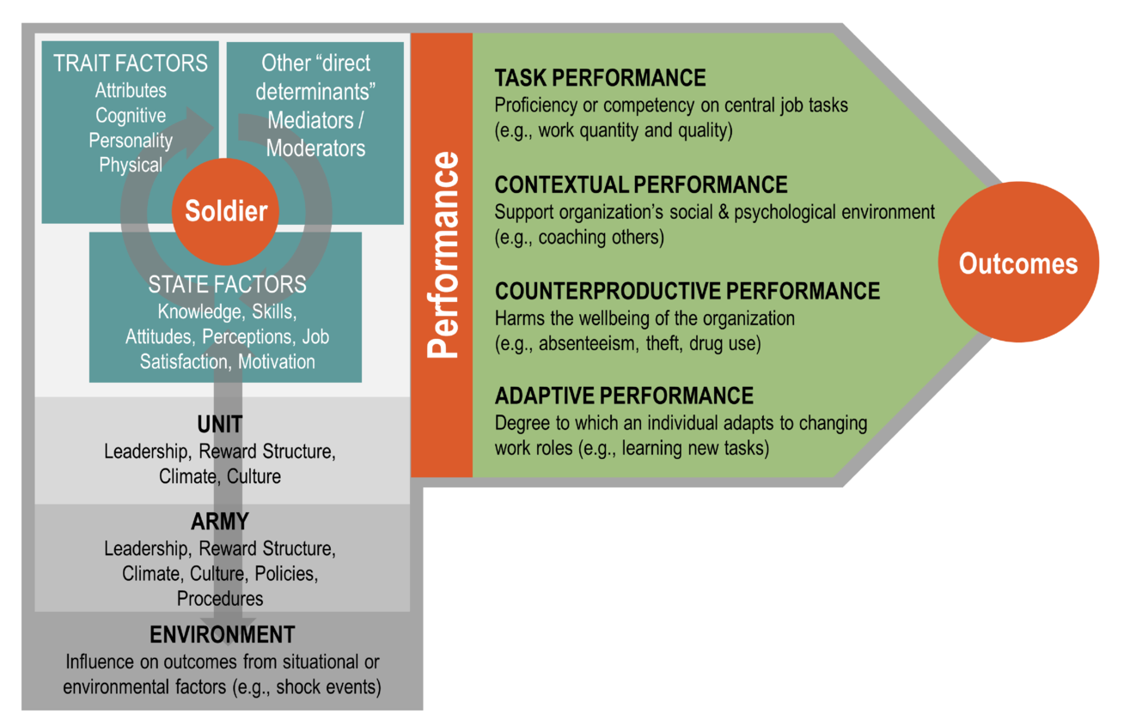
Conceptual Performance Framework
Notes:
Performance is "synonymous with behavior… something people actually do and can be observed… it includes only those actions or behaviors that are relevant to the organization’s goals and that can be scaled (measured) in terms of each individual’s proficiency (that is, level of contribution)."
Campbell et al., 1993
"Performance is an abstract, latent construct that cannot be pointed to or measured directly… made up of multiple components or dimensions [which are] made up of indicators that can be measured directly… Whereas the dimensions may generalize across jobs, the exact indicators can differ between jobs."
Koopmans, 2011

Slide 11
Additions to the Corpus
We acquired historical Army Leadership and Leadership Development doctrine and documents from Center for the Army Profession and Leadership (CAPL)
29 documents from 1946 to 2019
Spans several doctrine hierarchies, naming conventions
ADP, ADRP, AR, FM, etc.
Includes detailed metadata on the evolution of documents (e.g., introduction of new themes, changing leadership definitions) by year as tracked by CAPL
Year | Nomenclature | Title | Definition
1965 | FM 22-100 | Military Leadership | Military Leadership. The art of influencing and directing men in such a way as to obtain their willing obedience, confidence, respect, and loyal cooperation to accomplish the mission.
2012 | ADP/ADRP 6-22 | Army Leadership | Leadership is the process of influencing people by providing purpose, direction, and motivation to accomplish the mission and improve the organization.
Excerpt from CAPL "Evolution of Army Leadership Literature" metadata
Notes:
Describe corpus: Include full names and years for all documents
Information from https://uva-bi-sdad.github.io/dspg22ari2/data.html
Plus green documents, international comparison, 10 pams
Put whole title of 600-3

Slide 12
Technical Next steps
Refine document ingestion procedure to account for new and varied file formats
Check accuracy of document metadata
Standardize document metadata
Develop a comprehensive changelog to capture variation in document content (e.g., 2005-2006 Army doctrine renumbered to reflect joint numbering)
Will continue to work with student researcher from summer 2022
Notes:
Work on this after talking to Kathryn

Slide 13
Analytical Next steps
Document analysis
Iterate on previous methodological approaches (e.g., continue with same approach vs other options)
Topic Modeling (compare against CAPL's evolution document/manual coding)
Term Frequency-Inverse Document Frequency (TF-IDF)
Sentiment Analysis
How does the context or meaning of concepts change over time? Are there specific keywords to target in our analysis like we did for the inclusive language pronouns?
Terms emphasizing group or units
Performance
Leadership
Notes:
Work on this after talking to Kathryn

Slide 14
Modeling Performance

Slide 15
Modeling Social Constructs
Supplement models with social factors captured in GAT and TAPAS variables
Career outcomes (e.g., rate of promotion, final rank achieved) will serve as proxy for performance
Connect this to psychosocial traits as represented on GAT and TAPAS
Example research questions:
Do certain traits (e.g., adaptability, character) lead to better long term career performance (e.g., high rank)?
Does performance differ in relation to relatively stable traits vs changing traits (e.g., optimism vs work engagement)?
Comparison of model estimates produced when considering outliers (outperforming individuals)

Slide 16
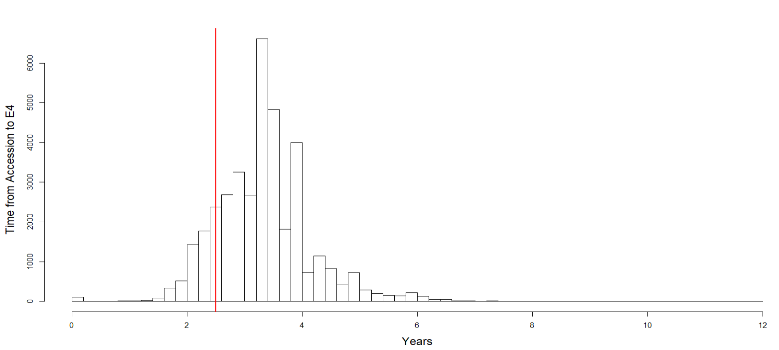
Model Cohort
Cohort: 184,035 Soldiers with two or more observed GAT responses from FY2009 to 2018
Model effects of social constructs on promotion speed (time from accession to E4)
Model likelihood of counterproductive behaviors.
Court Martial | 358
Article 15 Proceedings | 1300
Letter of Reprimand | 2137
Combat Arms | 69,522
Non-Combat Arms | 114,512
Distribution of time from accession to rank E4. The red line at 30 months represents standard eligibility requirements for promotion (source: AR 600-8-19 Enlisted Promotions and Reductions)

Slide 17
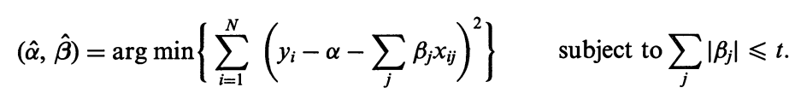
Modeling Time to Promotion
Linear modeling with variable selection (LASSO) to identify social constructs associated with faster promotion speeds.
Cohort: 148,812 Soldiers with two or more observed GAT responses from FY2009 to 2018
Response: Time from accession to E4.
Control for demographics and military history (including Education, Age, APFT scores, Court Martials and Article 15)

Slide 18
Model Results: Time to Promotion
Combat Arms:
Non-Combat Arms:
Age at Accession | .
AFQT | -0.021
Court Martials | .
Article 15 | .
Letters of Reprimand | .
Adaptability | -0.035
Active Coping | .
Passive Coping | .
Catastrophizing | .
Character | .
Depression | .
Optimism | .
Positive Affect | .
Negative Affect | .
Loneliness | .
Organizational Trust | .
Work Engagement | 0.016
Life Meaning | -0.15
Age at Accession | .
AFQT | -0.029
Court Martials | .
Article 15 | .
Letters of Reprimand | .
Adaptability | -0.024
Active Coping | .
Passive Coping | .
Catastrophizing | .
Character | .
Depression | .
Optimism | -0.008
Positive Affect | .
Negative Affect | .
Loneliness | .
Organizational Trust | .
Work Engagement | .
Life Meaning | -0.20
Interpretation of model effects:
Time is measured in years, social constructs are measured on a 5-point Likert scale, and AFQT scores range from 0-100.
An effect of -0.03 for AFQT tells us that an increase of ten points on the AFQT is associated with a 10x1-exp(-0.03)=0.3 years (16 weeks) expected decrease in promotion time.
An effect of –0.20 for Life Meaning tells us that a one-point increase on the Life Meaning scale is associated with a 1-exp(-0.20)=0.18 years (9.4 weeks) expected decrease in promotion time.

Slide 19
Modeling Early Promotions
Combat Arms:
Non-Combat Arms:
Age at Accession | .
AFQT | -0.004
Court Martials | .
Article 15 | 0.43
Letters of Reprimand | 0.048
Adaptability | .
Active Coping | .
Passive Coping | .
Catastrophizing | .
Character | .
Depression | .
Optimism | .
Positive Affect | .
Negative Affect | .
Loneliness | .
Organizational Trust | .
Work Engagement | 0.031
Life Meaning | .
Age at Accession | .
AFQT | -0.006
Court Martials | .
Article 15 | .
Letters of Reprimand | .
Adaptability | .
Active Coping | .
Passive Coping | .
Catastrophizing | .
Character | .
Depression | .
Optimism | .
Positive Affect | .
Negative Affect | .
Loneliness | .
Organizational Trust | .
Work Engagement | .
Life Meaning | .
Logistic modeling with variable selection (LASSO) to identify social constructs associated with "below the zone" promotion to E4 (faster than 30 months).
Binary response: Time from accession to E4 faster than 30 months.
Control for demographics and military history (including Education, Age, APFT scores, Court Martials and Article 15)

Slide 20
Predictive Models for Performance
Identify surrogate measures of performance as response variable, e.g.
First term Attrition of Army Enlisted Soldiers (binary response)
Time to promotion to given rank e.g., E6, E7 (ordinal response with k level)
Other measures (e.g., evaluation reports)
Identify sources for predictors
GAT and TAPAS
Demographics and military history
Other sources?
Choose modeling approach
Regression approach: Generalized linear model, logistic regression for binary response, ordinal regression for ordinal response
Classification approach: large margin classifier such as Support Vector Machine (SVM), decision tree learning (Random Forest), artificial neural networks, boosting (AdaBoost)

Slide 21
Challenges and Possible Solutions
High dimensional explanatory variables from GAT and other sources with potential collinearity
Manually construct indexes for different (ideally orthogonal) aspects of human/social dimension of soldier
Various modern variable selection approaches such as LASSO, SCAD, adaptive LASSO.
A combination of both 1 and 2
Temporal dynamics
Some of the variables (i.e., GAT) are measured annually. Can the temporal variation of such measure provide more insight to predict performance?
Modeling tools include time series model, functional linear model.
Is there enough temporal variation in the data to do such analysis?

Slide 22

Thoughts and Discussion
23

Slide 23
Additional SLides

Slide 24
Future Steps – Causal Inference
Modeling interactions between personal traits (physical/psychological/social) and performance.
Challenges: For each Soldier we only observe one outcome from multiple possible career outcomes, and career choice is likely not independent to personal traits.
Counterfactual model of causal effects and other causal inference approaches may be used.
Doubly Robust estimation approach to guard against misspecification of outcome model and propensity model
Designed experiments may be used to evaluate effectiveness of intervention and draw definitive causal inference.

Slide 25
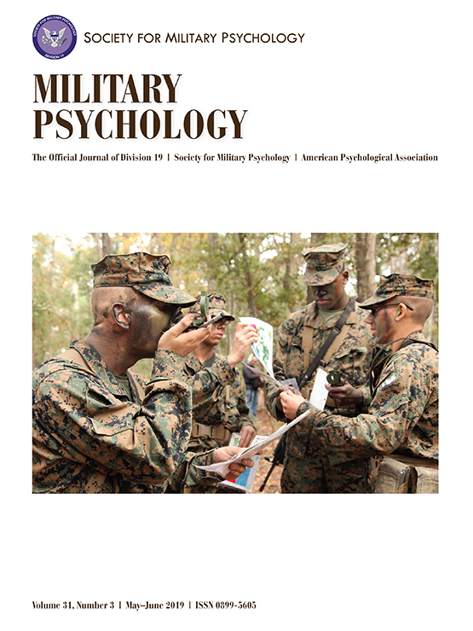
Longitudinal Stability of the GAT
Problem: The Global Assessment Tool (GAT) is measured annually, but the longitudinal psychometrics of the tool are undocumented
How: Examine whether GAT measures change over time at the population-level (e.g., mean-level changes, rank-order changes) and individual-level (e.g., reliable change).
Methods: t-tests, RM-ANOVA, RM-MLM, RM-SEM, reliable change index
Payoff: This research helps inform the psychometric characteristic of the GAT measures and how to integrate them into performance models.
Products & Transitions:
Comprehensive GAT ARI Tech Report (in DTIC: AD1147839, ARI TR 1397)
Extracted analysis of the GAT (in press at Military Psychology)
Draft of Mil Psych paper provided to the Army Resilience Directorate (ARD)
Participation in Azimuth Check Steering Committee for redesign
Notes:
Modified Brinley plots
Blampied, N. M. (2017). Analyzing therapeutic change using modified Brinley plots: History, construction, and interpretation. Behavior Therapy, 48, 115–127. https://doi.org/10.1016/j.beth.2016.09.002

Slide 26
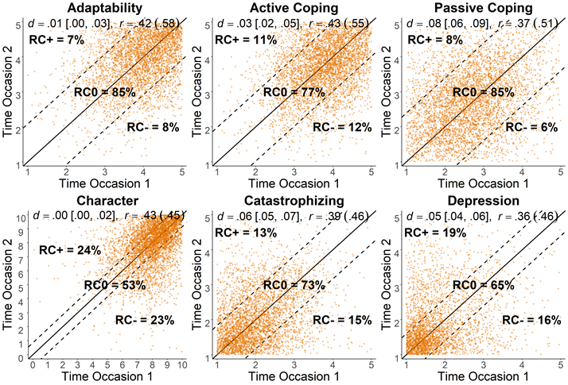
GAT Stability – Selected Results
Rank-Order Change: Pearson’s r
Mean-Level Change: Cohen’s d
Measures mostly stable over time except for organizational trust, work engagement, and life meaning
Individual-Level Change: Reliable Change Index
Measures predominately stable across different indicators of longitudinal change
Notes:
Modified Brinley plots
Blampied, N. M. (2017). Analyzing therapeutic change using modified Brinley plots: History, construction, and interpretation. Behavior Therapy, 48, 115–127. https://doi.org/10.1016/j.beth.2016.09.002

Slide 27
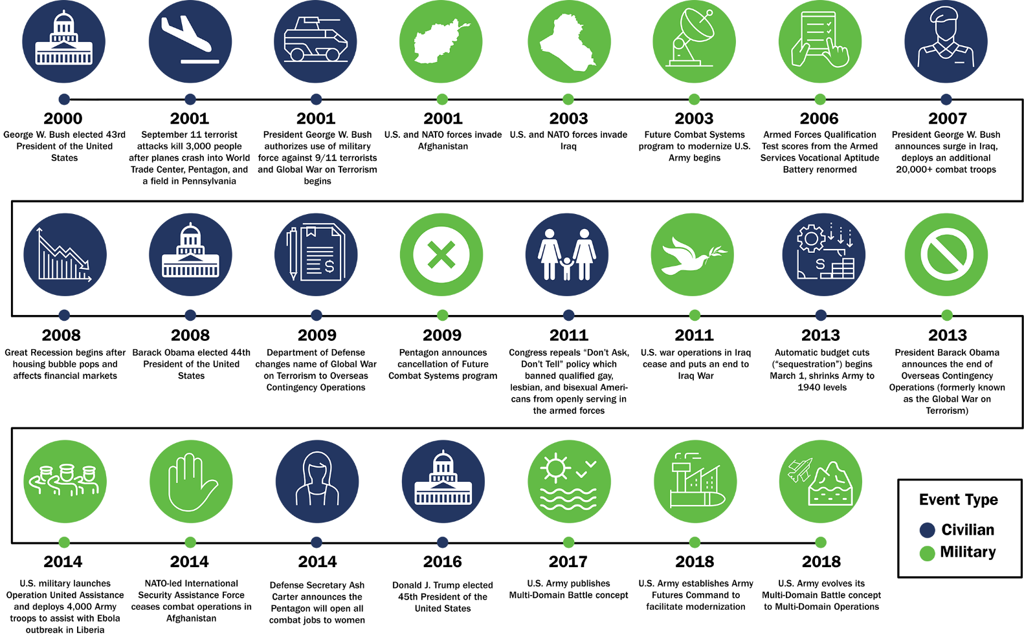
Timeline of Major Events Relevant to the U.S. Army from 2000-2019
27
Notes:
For our project in the PDE, we have access to just over 20 years of data…need to understand the contexts surrounding that timeframe to better inform modeling

Slide 28






20-Year Benchmark of the U.S. Army
Problem: Data are available for a 20-year time span, but it is not fully understood what trends occur over time and their potential broad impacts on changes in performance.
How: Benchmarking accession trends for U.S. Army Soldiers from 2000 to 2019.
Focus Areas:
Payoff: This research provides a quality check of our data with data reported publicly by the DOD and other DOD-affiliated research groups
Soldier Demographics and Home Location
Recruit Quality (Education & Armed Forces Qualification Test (AFQT) Scores)
Socioeconomic status
Soldier Health & Physical Fitness
Notes:
Inform our modeling, determine if data consistent with other publicly-reported results, data quality checks; provided a good exercise to immerse new team members into PDE data sources

Slide 29
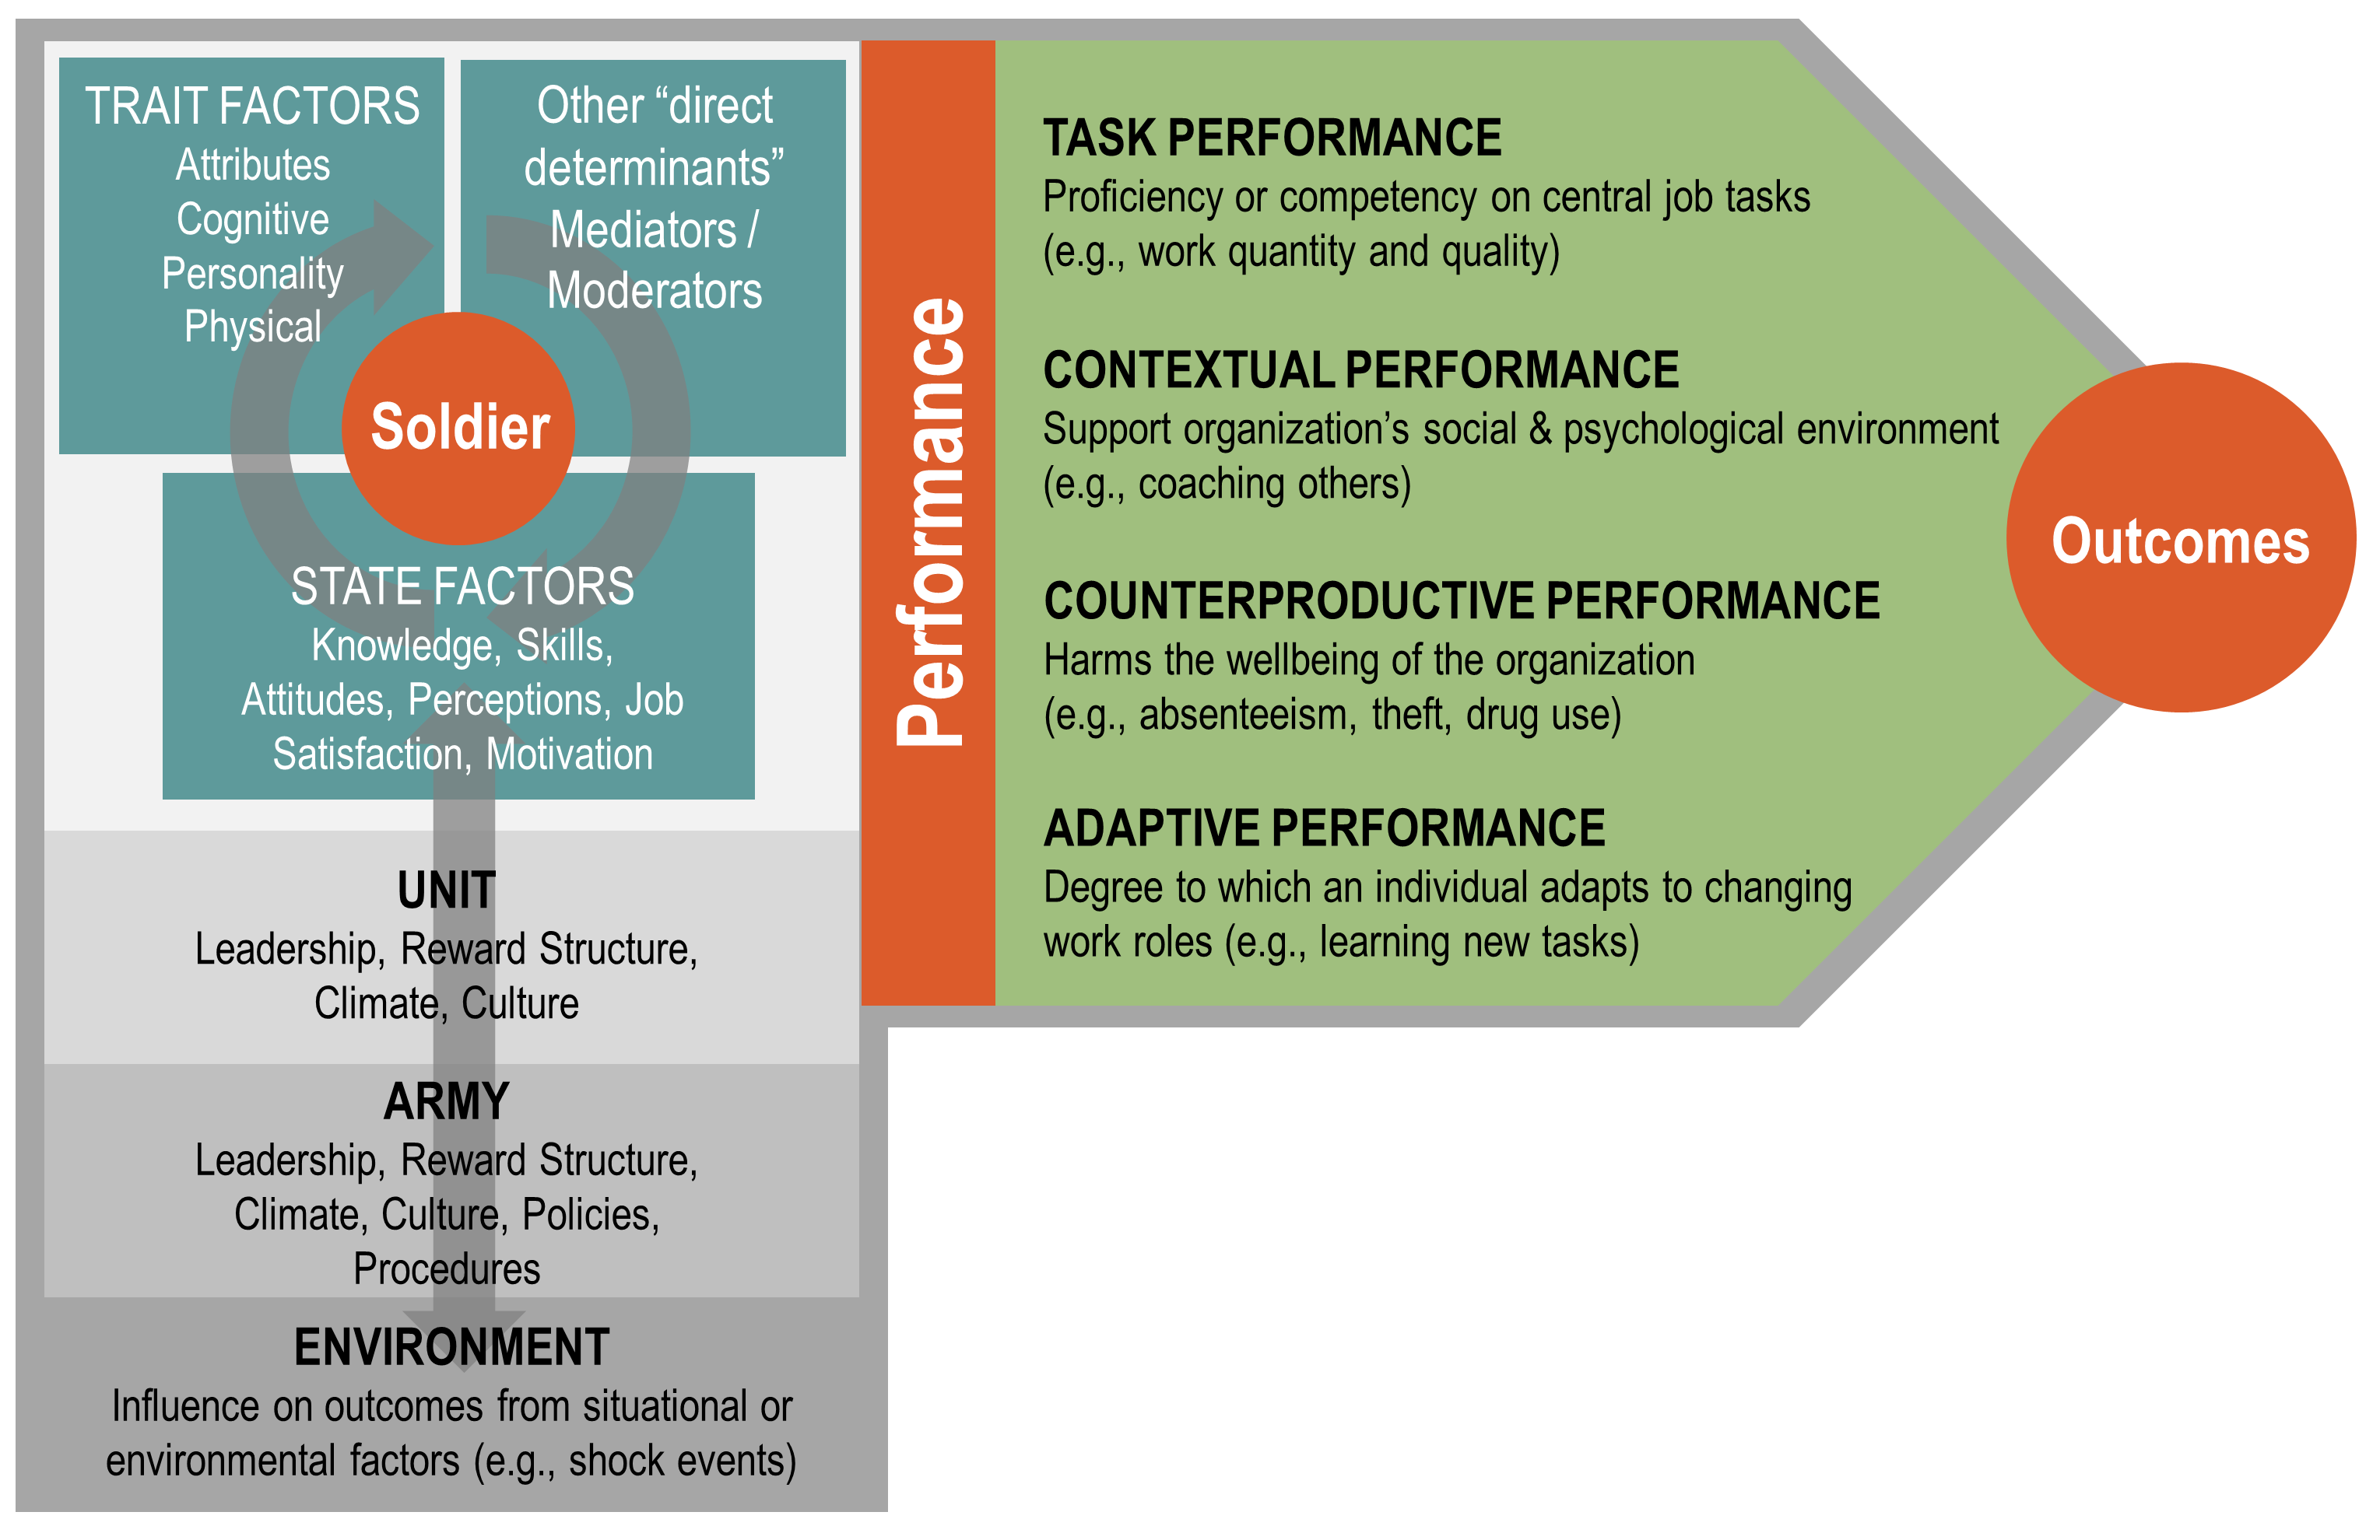
Conceptual Performance Model (CPM)
Master: Demographics (age, sex, race)
Master/Transaction:
Speed of Promotion
Master: Rank Group, MOS
ATMS: APFT Scores
MEPCOM: AFQT Score, Home Location, Education
ATMS: Body Composition
TAPAS: Personality Metrics
AWTF: Awards (Merit)
GAT: Psychosocial Metrics
Master: Duty Location,
Marital Status, Education
GAT: Psychosocial Metrics
PHA: PULHES Score
ATMS: Training, Weapon Qual.
ATRRS: Training, Coursework
FAM SPON: Dependents
Transaction: First-Term Attrition
CTS: Deployment History
Transaction: Character of Service
DEOCS: Climate Survey
TBD
IPERMS: Derogatory Statements (Misconduct)
URI: Unit Risk Inventory
PHA: AUDIT-C (Alcohol Misuse)
DEOCS: Climate Survey
Census: Demographics, ACS
Doctrine: FMs, ADRPs
BLS: Unemployment
CDC: BMI
30
Notes:
Wanted to ensure that our data matches those reported in public releases, looked at accessions and Army cohort compositions and matched results with those in DOD demographics reports and RAND accession reports.

Slide 30
Crosswalk of DOD Demo Reports & PDE Data
Top Level Cohort Numbers
Note. DOD Demographic Reports include reservists and guard on ‘active status’
Notes:
Note: DOD Demo Reports include reservists and guard on ‘active status’

Slide 31
Crosswalk of RAND Report & PDE Data
Top Level Accession Numbers

Slide 32
Phase 1 Performance Modeling
Problem: The Army possesses a trove of administrative data, but it is unclear if the data can be leveraged to construct models of Soldier performance
How: Conduct descriptive analyses, simple relationship analyses (using a single predictor and single outcome variable), and dominance analyses.
Methods: descriptive statistics, correlation, simple linear regression, generalized linear model, ANOVA
Payoff: This research could provide a baseline understanding of performance relationships in the Army and areas for further study.
Products & Transitions:
Phase 1 Performance Modeling ARI Tech Report (under review with ARI)
Notes:
Want to examine a baseline understanding of predictors and outcomes related to performance using PDE data.
Descriptive Statistics
Statistics (e.g., means, SDs, min/max, skewness, kurtosis)
Assumption Checks (e.g., normality, linearity)
Simple Relationships
Categorical (e.g., F-tests, one-way ANOVA)
Continuous (e.g., correlation, simple linear regression, generalized linear model)
Dominance Analysis
Exhaustive subsets of all possible combination of variables (Top 7) in nested models
General dominance: An average of R² (variance explained) across all nested models
Complete dominance: Does a given variable dominate another across all nested models (‘1’), none (‘0’), or a mix/indeterminate (‘0.5’)

Slide 33
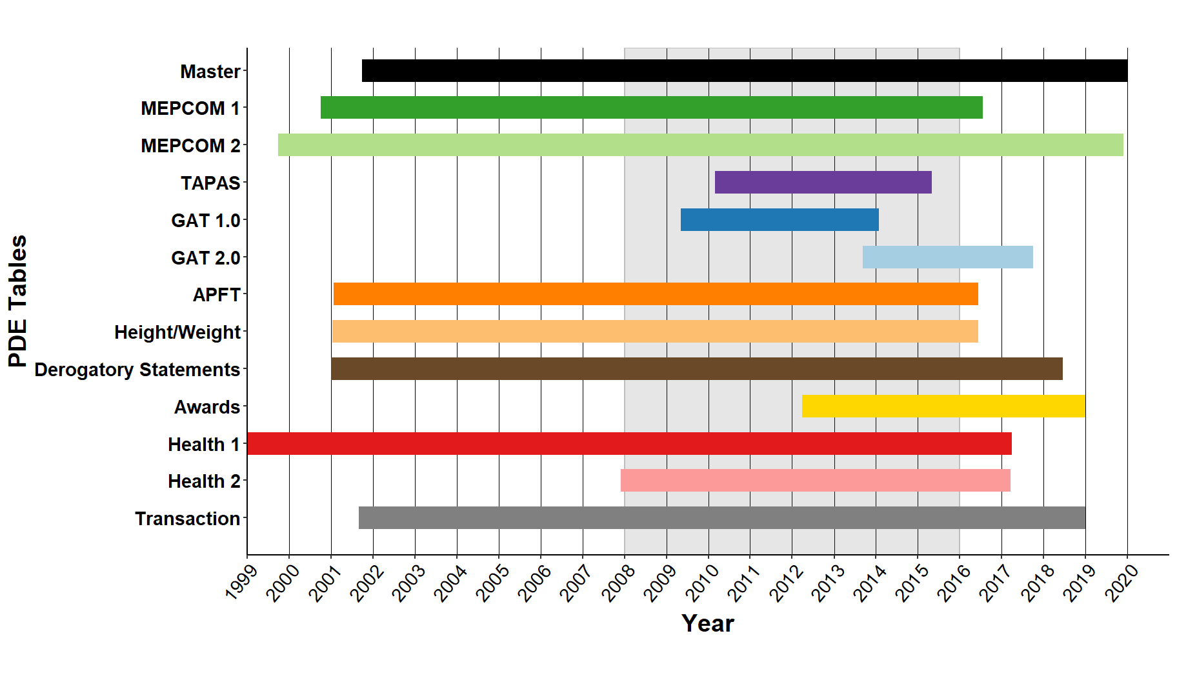
Phase 1 Modeling Data Time
Grey area = sample used for Phase 1 analysis based on accession year (2008–2015)
Notes:
One of the challenges is not all the data sources cover the same time span

Slide 34
CPM – Phase 1 Variables
Master: Demographics (age, sex, race)
Master/Transaction:
Speed of Promotion
Master: Rank Group, MOS
ATMS: APFT Scores
MEPCOM: AFQT Score, Home Location, Education
ATMS: Body Composition
TAPAS: Personality Metrics
AWTF: Awards (Merit)
GAT: Psychosocial Metrics
Master: Duty Location,
Marital Status, Education
GAT: Psychosocial Metrics
PHA: PULHES Score
ATMS: Training, Weapon Qual.
ATRRS: Training, Coursework
FAM SPON: Dependents
Transaction: First-Term Attrition
CTS: Deployment History
Transaction: Character of Service
DEOCS: Climate Survey
TBD
IPERMS: Derogatory Statements (Misconduct)
URI: Unit Risk Inventory
PHA: AUDIT-C (Alcohol Misuse)
DEOCS: Climate Survey
Census: Demographics, ACS
Doctrine: FMs, ADRPs
BLS: Unemployment
CDC: BMI
35
Notes:
Phase 2 modeling ideas for the meeting Wednesday and try to come prepared with a conceptual model sketch of what variables you would like to examine together.
Master = Active Duty Master File; MOS = Military Occupational Specialty; MEPCOM = Military Entrance and Processing Command; TAPAS = Tailored and Adaptive Personality Assessment System; GAT = Global Assessment Tool; PHA = Periodic Health Assessment; ATMS = Army Training Management System; ATRRS = Army Training and Requirements Resource System; FAM SPON = Family Sponsor; CTS = Contingency Tracking System; DEOCS = Defense Organizational Climate Survey; AWTF = Army Workforce Transaction File; IPERMS = Interactive Personnel Elective Records Management System; BLS = U.S. Bureau of Labor Statistics; CDC = U.S. Center for Disease Control; AFQT = Armed Forces Qualification Test; APFT = Army Physical Fitness Test; PULHES = (P), upper extremities (U), lower extremities (L), hearing and ears (H), eyes (E), and psychiatric (S);
The distillation of the literature on military and non-military performance led us to develop a Hierarchal Performance Framework (see Figure 1). The framework builds on existing performance taxonomies (e.g., Campbell et al., 1993; Campbell & Wiernik, 2015; Koopmans et al., 2011) and operationalizes them into a framework that is more relevant to Soldier performance. It is grounded in the definition of performance as a behavior or action that people engage in to further the goals of the organization that can be quantified or scaled (measured) in terms of each individual’s proficiency (i.e., level of contribution) or as a collective action at the group level. In this model, we make the assumption that the behaviors people engage in represent a manifestation of the underlying (latent) characteristics for two types: (1) performance enhancing behaviors (i.e., task performance, contextual performance, adaptive performance), defined as work behaviors that contribute to group or organizational goals; and (2) performance diminishing behaviors (i.e., counterproductive performance), defined as work behaviors that impede progress toward a group’s or organization’s goals. These productive and counterproductive behaviors can be directed at the organization, colleagues, and self. Antecedent (indirect) influences of performance in the framework include motivation, creativity, the Big Five personality traits, job satisfaction, unit culture, living of Army Values, and others. Outcomes of performance include valued metrics of interest to the Army unit or organization but might not necessarily be fully under an individual’s control such as attrition, mission success, and promotion rates to name a few.

Slide 35
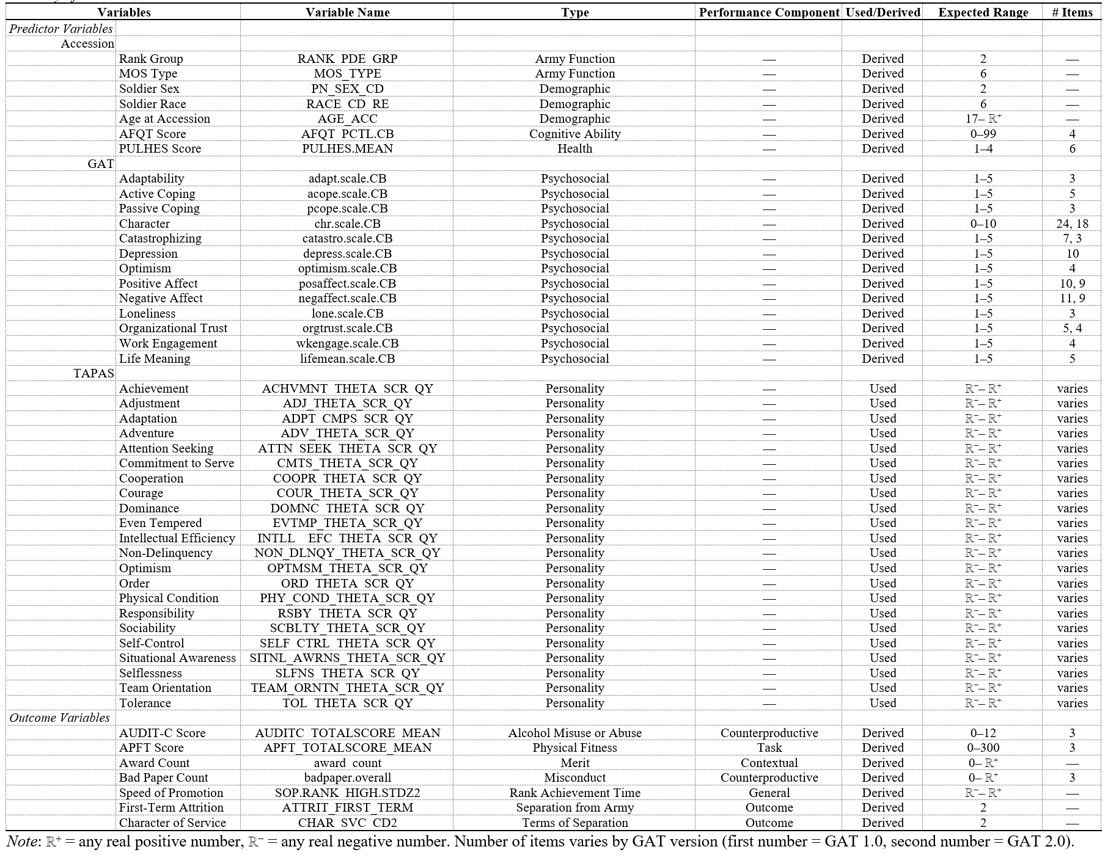
Phase 1 Modeling - Variable Selection
Informed by conceptual profiling process
A non-exhaustive total of 42 predictor variables and 7 outcome variables were selected for initial Phase 1 modeling of simple relationships
Notes:
Conceptual profiling process informed selection of predictor and outcome variables as well as data quality constraints
General Predictor Variable Selection Criteria:
Must have PID for data source table linkage
Demographic and/or psychosocial variables of interest to the Army which fit Conceptual Performance Model
Trait-based characteristic or attribute
General Outcome Variable Selection Criteria:
Must have PID for data source table linkage
Was categorized as a of type of performance (based on Koopman et al., 2011) and/or was a outcome of interest to the Army (e.g., attrition, character of service)
Measured at a single time point (e.g., character of service) or a single value could be derived to represent a Soldier’s career (e.g., mean APFT Score)
More variables can be examined as we move into Phase 2 modeling of more complex models and relationships. Results of modeling in Phase 1 can inform selection in Phase 2.

Slide 36
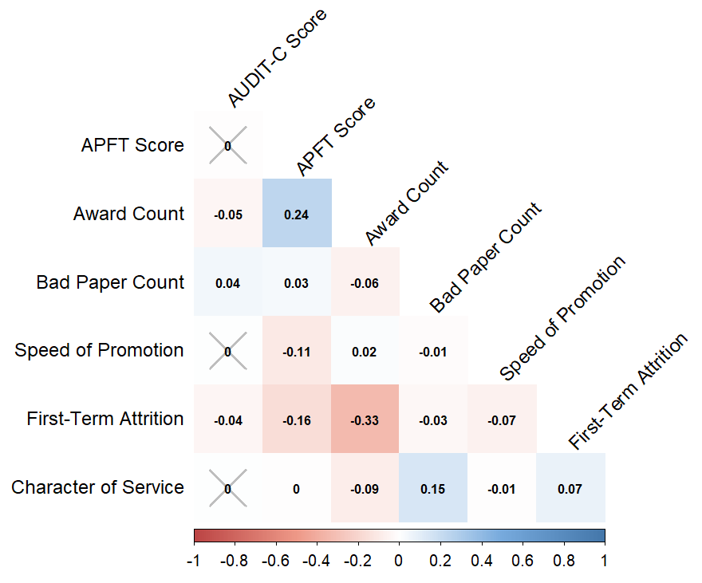
Phase 1 Modeling – Selected Results
Performance and Outcome Variables
Notes:
Discharge missing due to Soldiers still in Army; those with higher number of awards have higher APFT scores

Slide 37
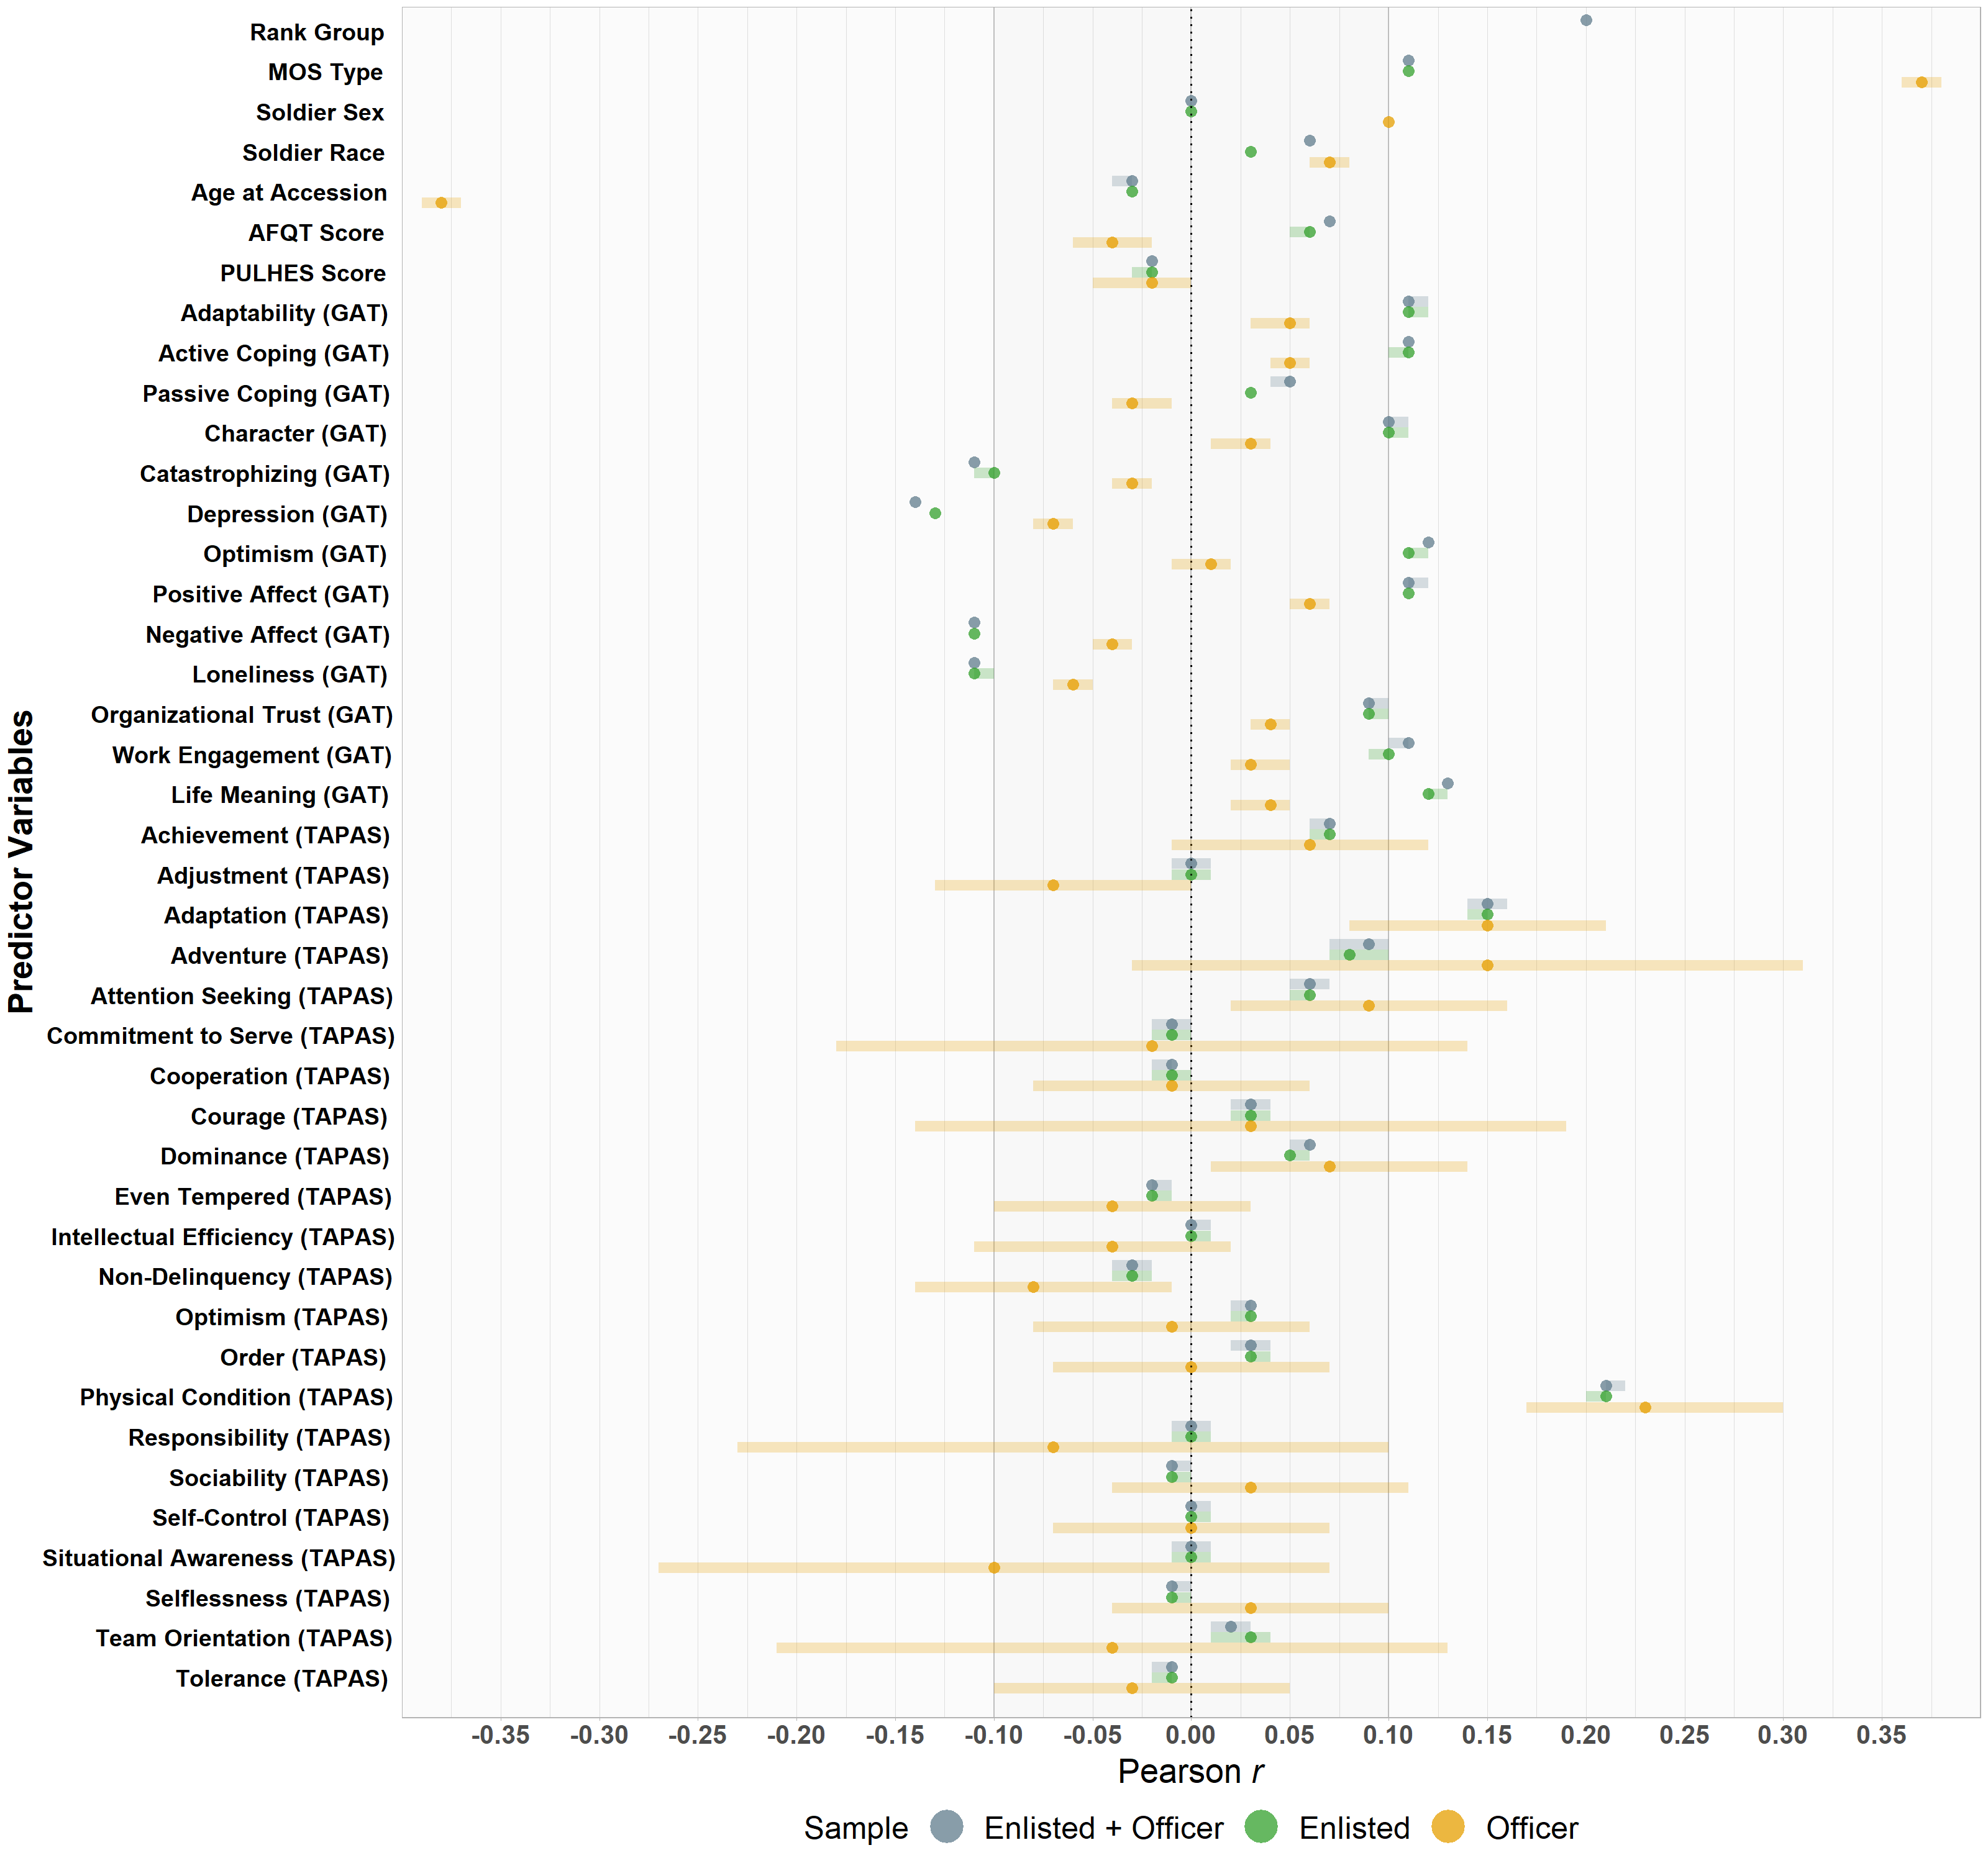



Phase 1 Modeling – Selected Results
Older officers score lower
Enlisted > Officer
Enlisted > Officer
Simple Relationship Analysis: Predictors with average APFT Score over a Soldier’s career
Depression negatively predicts APFT scores
Physical Condition trait positively predicts APFT scores
Notes:
Effect size indices are used due to large sample sizes…(converted to common metric of Pearson’s r)

Slide 38
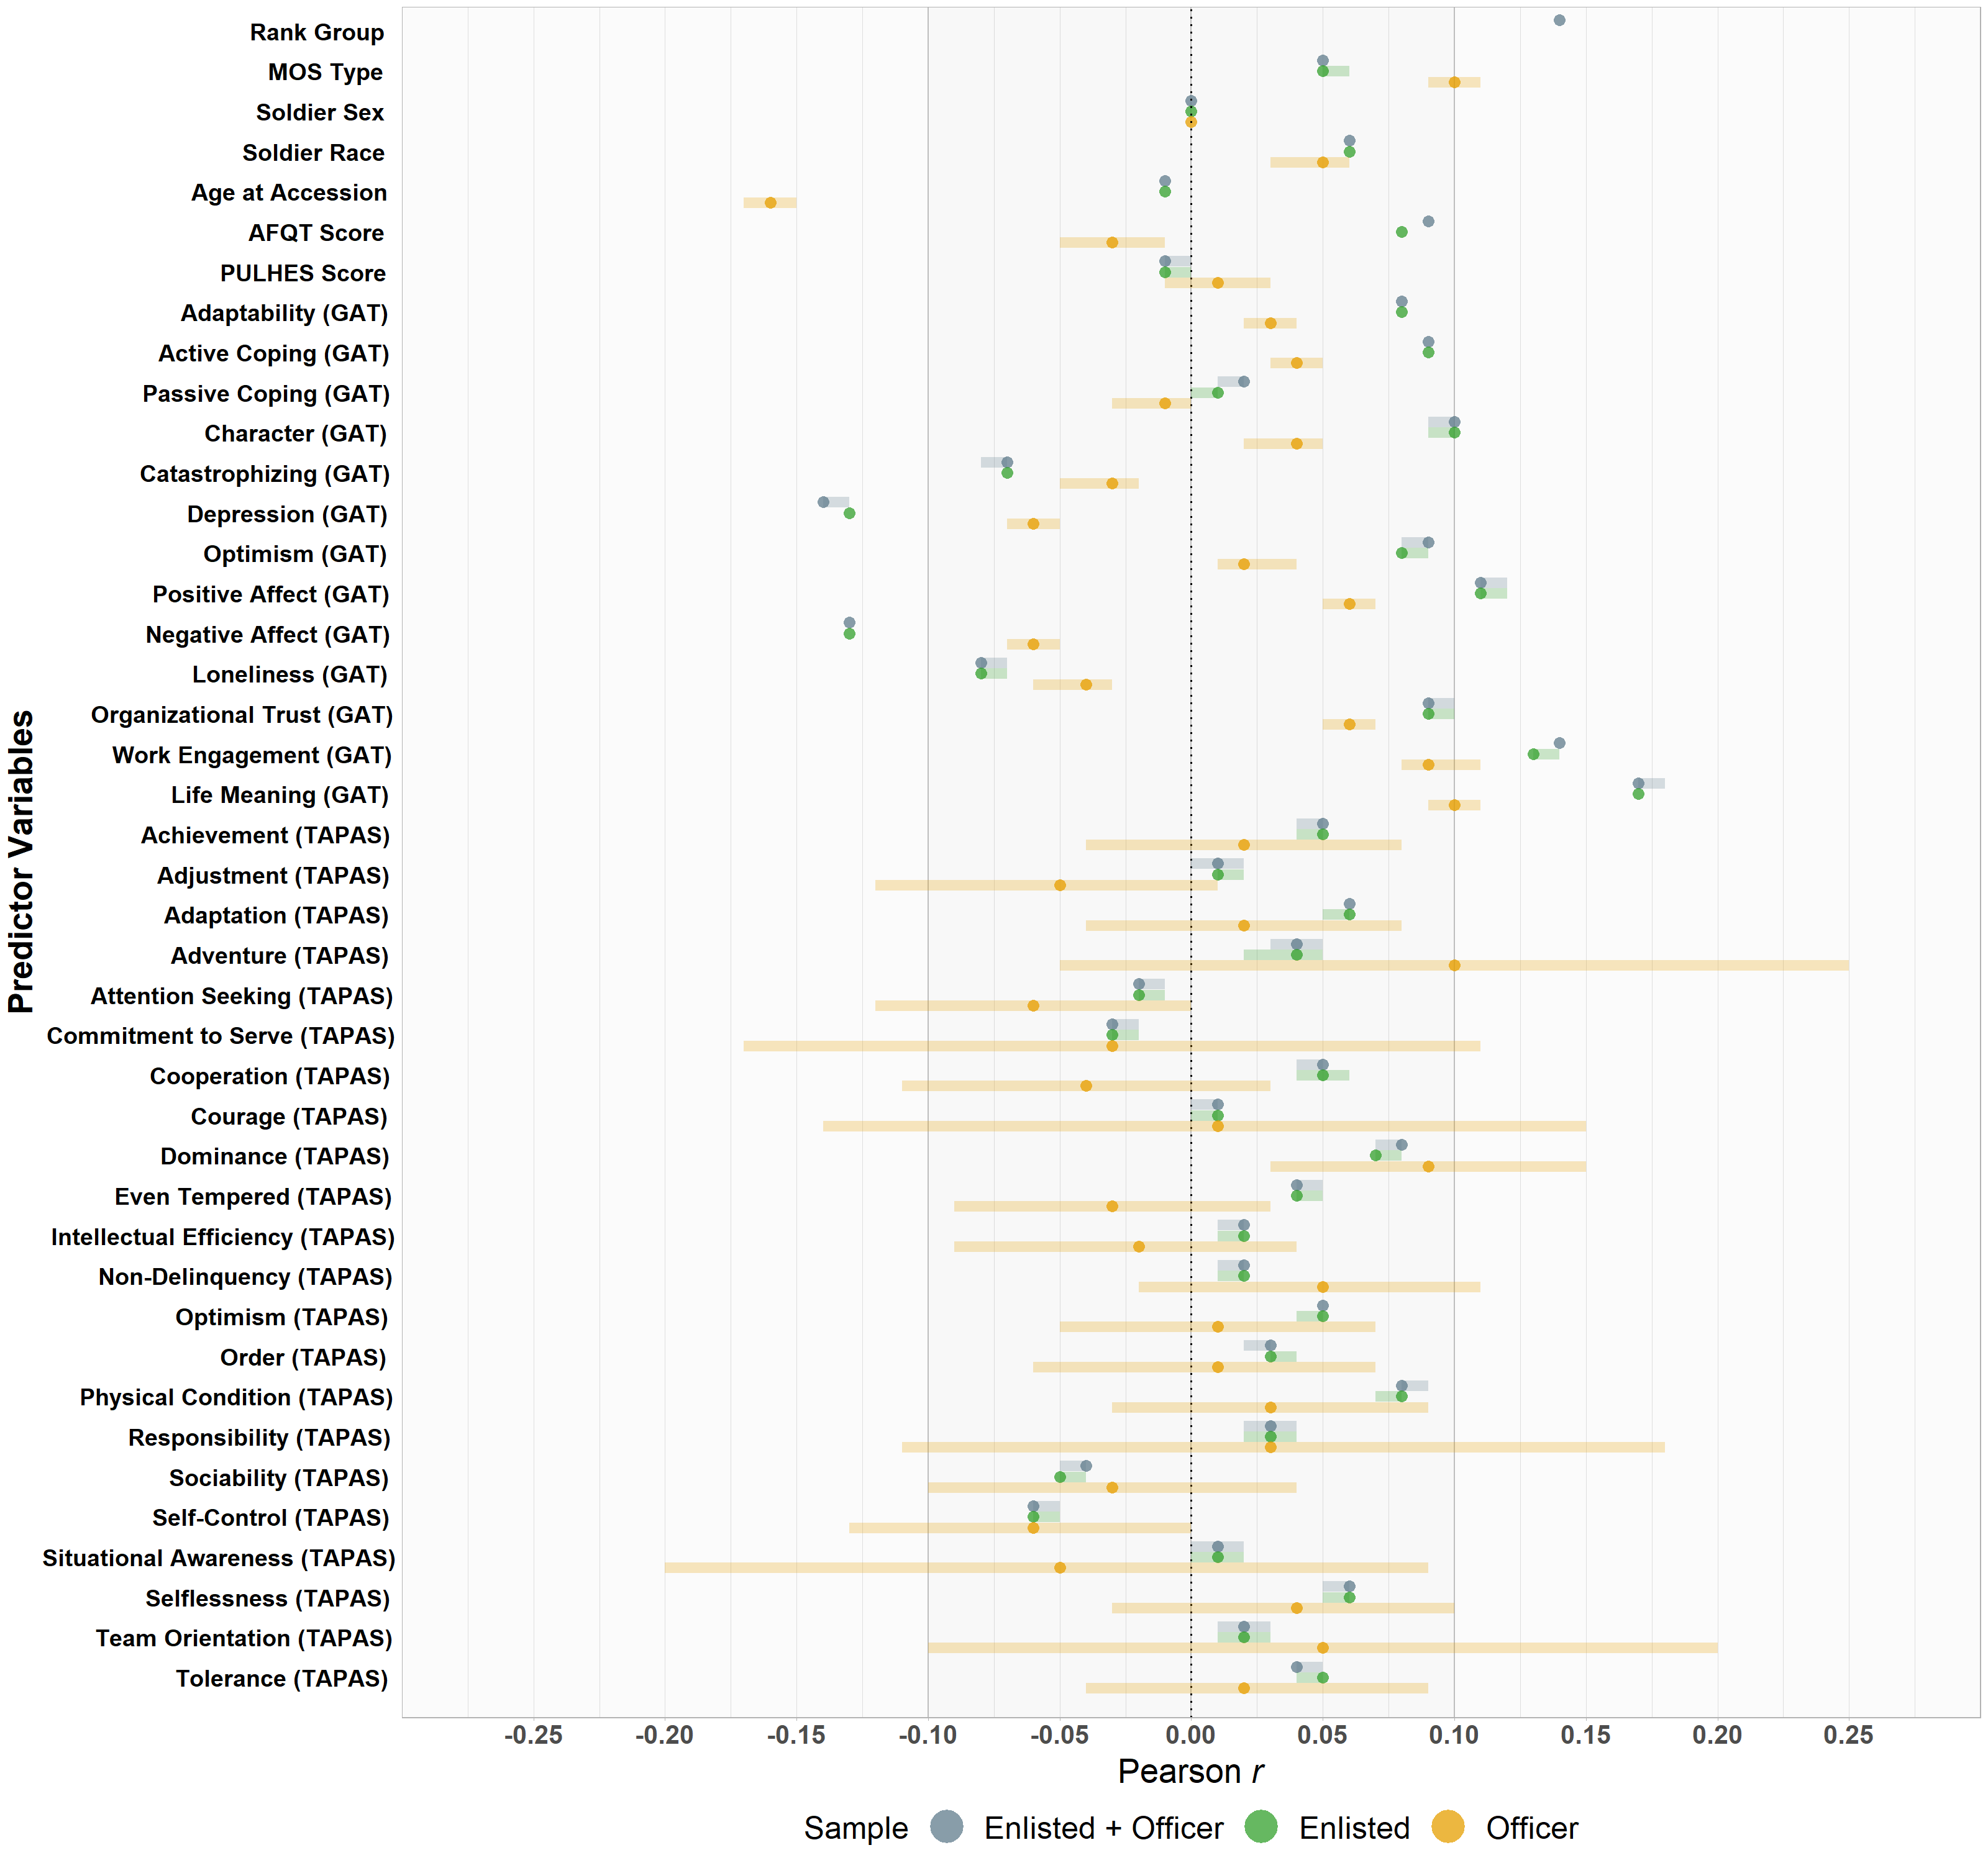


Phase 1 Modeling – Selected Results
Officer > Enlisted
Simple Relationship Analysis: Predictors with Award Count over a Soldier’s career
Life Meaning positively predicts Award Count
Depression & Neg. Affect Negatively predicts Award Count

Slide 39
Conceptual Performance Model
Master: Demographics (age, sex, race)
Master/Transaction:
Speed of Promotion
Master: Rank Group, MOS
ATMS: APFT Scores
MEPCOM: AFQT Score, Home Location, Education
ATMS: Body Composition
TAPAS: Personality Metrics
AWTF: Awards (Merit)
GAT: Psychosocial Metrics
Master: Duty Location,
Marital Status, Education
GAT: Psychosocial Metrics
PHA: PULHES Score
ATMS: Training, Weapon Qual.
ATRRS: Training, Coursework
FAM SPON: Dependents
Transaction: First-Term Attrition
CTS: Deployment History
Transaction: Character of Service
DEOCS: Climate Survey
TBD
IPERMS: Derogatory Statements (Misconduct)
URI: Unit Risk Inventory
PHA: AUDIT-C (Alcohol Misuse)
DEOCS: Climate Survey
Census: Demographics, ACS
Doctrine: FMs, ADRPs
BLS: Unemployment
CDC: BMI
40
Notes:
Phase 2 modeling ideas for the meeting Wednesday and try to come prepared with a conceptual model sketch of what variables you would like to examine together.
Master = Active Duty Master File; MOS = Military Occupational Specialty; MEPCOM = Military Entrance and Processing Command; TAPAS = Tailored and Adaptive Personality Assessment System; GAT = Global Assessment Tool; PHA = Periodic Health Assessment; ATMS = Army Training Management System; ATRRS = Army Training and Requirements Resource System; FAM SPON = Family Sponsor; CTS = Contingency Tracking System; DEOCS = Defense Organizational Climate Survey; AWTF = Army Workforce Transaction File; IPERMS = Interactive Personnel Elective Records Management System; BLS = U.S. Bureau of Labor Statistics; CDC = U.S. Center for Disease Control; AFQT = Armed Forces Qualification Test; APFT = Army Physical Fitness Test; PULHES = (P), upper extremities (U), lower extremities (L), hearing and ears (H), eyes (E), and psychiatric (S);
The distillation of the literature on military and non-military performance led us to develop a Hierarchal Performance Framework (see Figure 1). The framework builds on existing performance taxonomies (e.g., Campbell et al., 1993; Campbell & Wiernik, 2015; Koopmans et al., 2011) and operationalizes them into a framework that is more relevant to Soldier performance. It is grounded in the definition of performance as a behavior or action that people engage in to further the goals of the organization that can be quantified or scaled (measured) in terms of each individual’s proficiency (i.e., level of contribution) or as a collective action at the group level. In this model, we make the assumption that the behaviors people engage in represent a manifestation of the underlying (latent) characteristics for two types: (1) performance enhancing behaviors (i.e., task performance, contextual performance, adaptive performance), defined as work behaviors that contribute to group or organizational goals; and (2) performance diminishing behaviors (i.e., counterproductive performance), defined as work behaviors that impede progress toward a group’s or organization’s goals. These productive and counterproductive behaviors can be directed at the organization, colleagues, and self. Antecedent (indirect) influences of performance in the framework include motivation, creativity, the Big Five personality traits, job satisfaction, unit culture, living of Army Values, and others. Outcomes of performance include valued metrics of interest to the Army unit or organization but might not necessarily be fully under an individual’s control such as attrition, mission success, and promotion rates to name a few.

